Slide 1
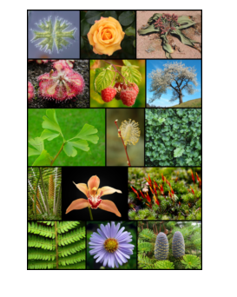
Plant Kingdom

Slide 2
Introduction to Kingdom Plantae
Fundamental Features
1. Most of the plants are eukaryotic and chlorophyll containing organisms. Cell walls of plant cells are comprised of cellulose.
2. They have an ability to grow by cell division.

Slide 3
8. Organisms within Kingdom Plantae are multicellular, eukaryotic and autotrophic.
9. The Kingdom Plantae includes plants which are multicellular, eukaryotic, photosynthetic and producers.
10. The plant body may be thalloid or differentiated into root, stem and leaves. They may be non vascular or vascular.

Slide 4
11. They have two stages in their life cycle:
12. Haploid, sexually reproducing gametophytic generation.
13. Diploid, asexually reproducing saprophytic generation. The two generations alternate. So it is called alternation of generations.

Slide 5
What do you mean by plant kingdom?
Plants are mainly multicellular, predominantly photosynthetic eukaryotes of the kingdom Plantae.
Historically, plants were treated as one of two kingdoms including all living things that were not animals, and all algae and fungi were treated as plants.

Slide 6
Biologist R.H. Whittaker gave us the Five Kingdom Classification.
Protista,
Monera,
Fungi,
Plantae,
Animalia.

Slide 7
When you enter this kingdom, all you will find is plants . You will be amazed to see the different kinds of plants that are included here. You can see microscopic plants like the algae as well as the tallest trees like the Sequoia.
Some plants have the most beautiful and attractive looking structures called flowers, while some don’t have any.
In some plants, you can see a proper root system, shoot system, and leaves, while in the simpler plants, it is just a thalloid structure.

Slide 8
Who discovered plant kingdom?
R.H Whittaker originally wanted to include all producers in the plant kingdom.
He was now willing to relegate unicellular algae and cyanobacteria to his new kingdom Protista, but Whittaker continued to place all multicellular producers in kingdom Plantae

Slide 9
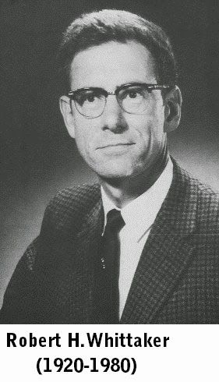
R.H Whittaker

Slide 10
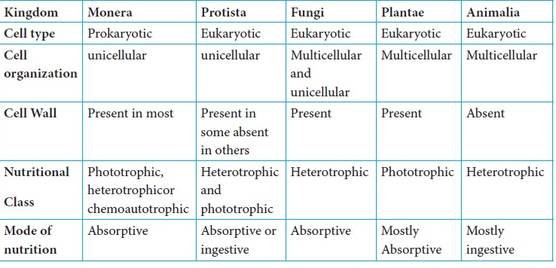
DIFFERENCES BETWEEN FIVE KINGDOM CLASSES

Slide 11
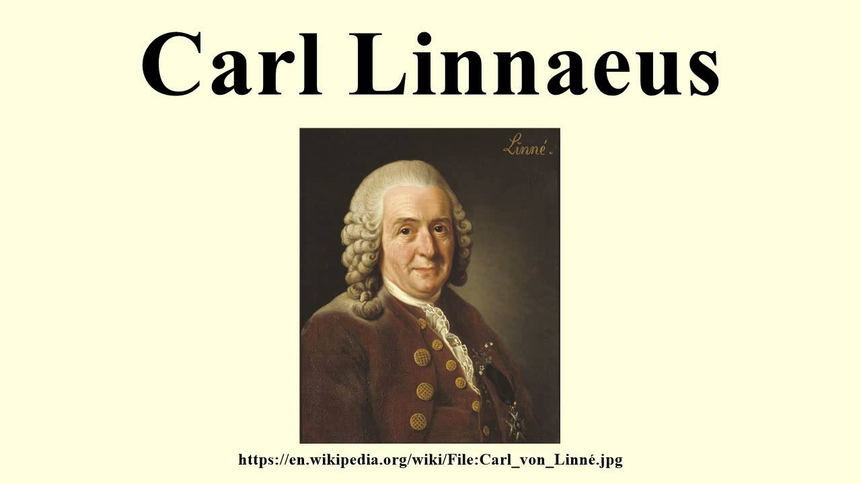
Carolus Linnaeus: [1707 – 1778]
He is known as father of taxonomy, Linnaeus gave the two kingdom system classification.
He grouped plants and animals into kingdom plantae and kingdom Animalia respectively.

Slide 12
What is mean by Classification
Classification, in biology, the establishment of a hierarchical system of categories on the basis of presumed natural relationships among organisms.
The science of biological classification is commonly called taxonomy.

Slide 13
Types of Classification:
1. Artificial system of classification
2. Natural classification system
3.Phylogenetic classification system (Evolution bases)
4. Numeral Taxonomy ( Names)
5. Cytotaxonomy (Cells)
6. Chemo taxonomy (Chemicals)

Slide 14
Artificial system of classification
Artificial classification The ordering of organisms into groups on the basis of non-evolutionary features (e.g. the grouping together of plants according to the number and situation of their stamens, styles, and stigmas rather than their evolutionary relationships)..

Slide 15
Natural classification system
A natural system for classification of seed plants was proposed by Bentham and Hooker (1862-1883) in their three-volume treatise 'Genera Plantarum'.

Slide 16
The natural system of classification of organisms is according to a relationship based on descent from a common ancestor.
In this classification, the organism is classified on the basis of their vegetative characters which are permanent and do not change with the environment

Slide 18
Phylogenetic classification system (Evolution bases )
Phylogenetic classification system is based on the evolutionary ancestry. ... It generates trees called cladograms, which are groups of organisms that include an ancestor species and its descendants.

Slide 19
Classifying organisms on the basis of descent from a common ancestor is called phylogenetic classification.
Linnaeus classified organisms based on obvious physical traits. Basically, organisms were grouped together if they looked alike.
After Darwin published his theory of evolution in the 1800s, scientists looked for a way to classify organisms that showed phylogeny.

Slide 20
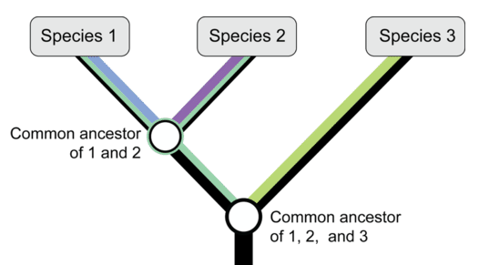
The Phylogeny is the evolutionary history of a group of related organisms. It is represented by a phylogenetic tree, like the one in Figure below.

Slide 21
One way of classifying organisms that shows phylogeny is by using the clade. A clade is a group of organisms that includes an ancestor and all of its descendants. Clades are based on cladistics.
This is a method of comparing traits in related species to determine ancestor-descendant relationships. Clades are represented by cladograms, like the one in Figure below.

Slide 22
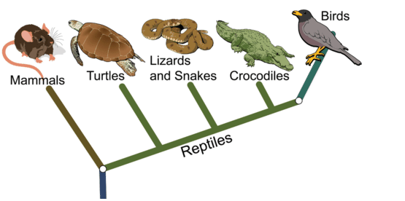
This cladogram classifies mammals, reptiles, and birds
in clades based on their evolutionary relationships.

Slide 23
This cladogram represents the mammal and reptile clades. The reptile clade includes birds.
It shows that birds evolved from reptiles. Linnaeus classified mammals, reptiles, and birds in separate classes. This masks their evolutionary relationships.

Slide 24
Advantages Phylogenetic classification
Phylogenetic classification has two main advantages over the Linnaean system.
First, phylogenetic classification tells you something important about the organism: its evolutionary history.
Second, phylogenetic classification does not attempt to "rank" organisms.

Slide 25
Numerical taxonomy
Numerical taxonomy is the method of classifying organisms with the help of numerical methods. ...
Michel Adanson, a French botanist, planned to assign numerical values to the similarities between organisms and he proposed that equal weightage should be given to all the characters while classifying plants.

Slide 26
Numerical taxonomy is a system of grouping of species by numerical methods based on their character states. It was first initiated by Peter H.A.Sneath

Slide 27
Cytotaxonomy
Cytotaxonomy is a biology dealing with the classification and relationships of organisms using detail studies of chromosomes.

Slide 28
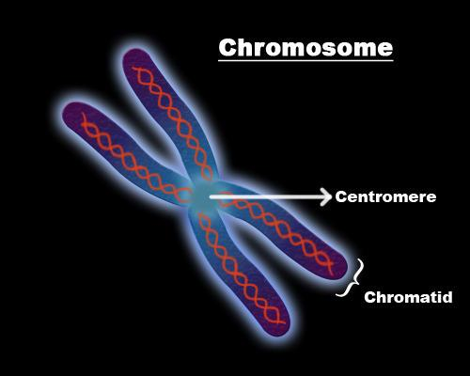
CHROMOSOMES

Slide 29
The properties of chromosomes are of great value in taxonomy, because the chromosome number being the most widely used and quoted character in biology

Slide 30
Chemotaxonomy
Chemotaxonomy as the method of biological classification based on similarities in the structure of certain compounds among the organisms being classified. ... Since working of the organs involves chemicals of the body, these compounds are called biochemical evidences.
Chemotaxonomy of cyanobacteria was initiated by Kenyon (1972).

